Slide 1
Inverse problems and imaging
Recap of last class
Inverse problems and DNA
Another inverse problem in medical imaging. Light attenuation model and the Radon transform
Working with images in Matlab

Slide 2
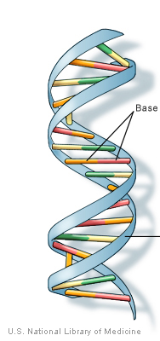
Photograph 51, FT, double helix

Slide 3
Medical imaging “Reconstruction” problems

Slide 4
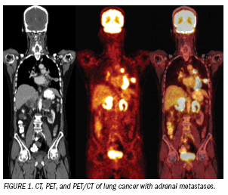
Medical imaging
Many medical images result from solving an inverse problem
Notes:
PET, CT, MRI

Slide 5
Enter patient: 65 year old man
Persistent dry cough
Mild fatigue
Smoked a pack a day for a decade
Lost 10 – 15 pounds in last six months

Slide 6
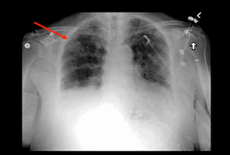
Patient’s chest x-ray
Photo credit: Dr. Joseph Levine
Notes:
- Concerning feature ~ 5cm
- Emphysema?

Slide 7
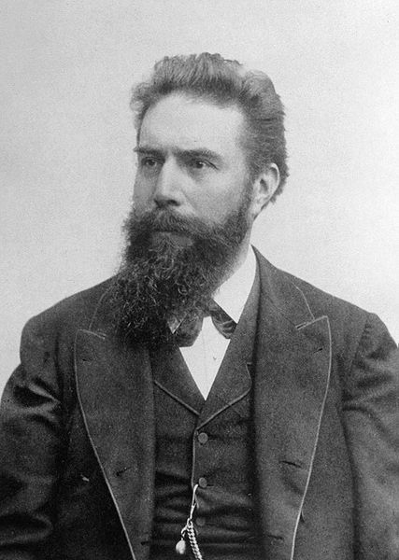
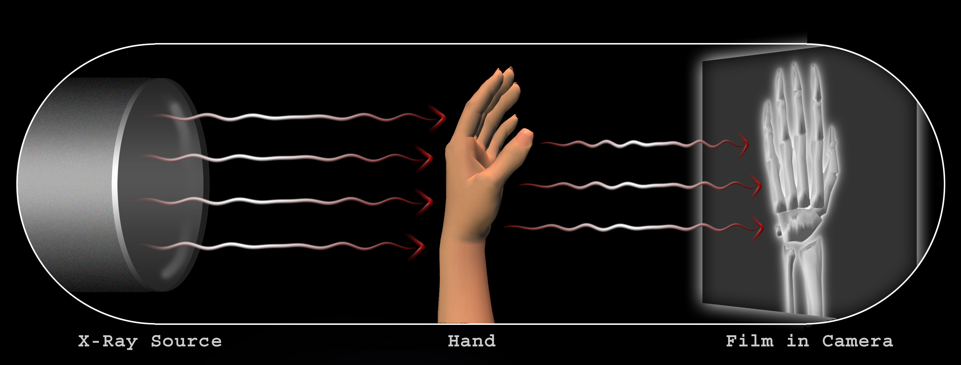
Conventional x-rays
Roentgen (1895):
experiments with electron beams
1901: first physics Nobel

Slide 8
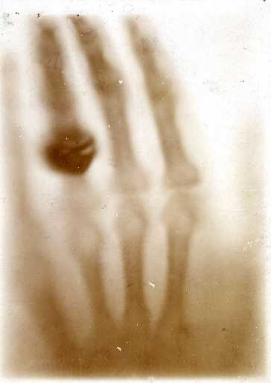
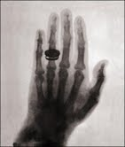
First radiographs
Roentgen’s wife’s hand (1895)
Colleague’s hand (1896)
https://en.wikipedia.org/wiki/Wilhelm_Röntgen

Slide 9
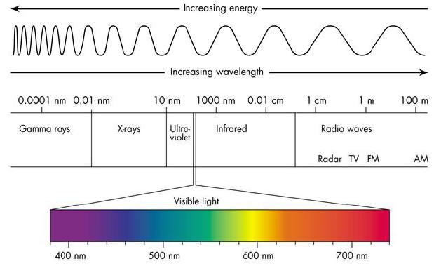
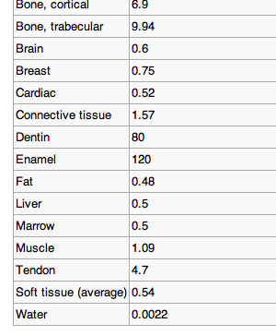
Electromagnetic spectrum
Material
Attenuation
(1/cm)

Slide 10
Activity: model for attenuation?

Slide 11
Attenuation: uniform material

Slide 12
Attenuation: nonuniform material

Slide 13
Attenuation: nonuniform material
. . .

Slide 14
Attenuation: nonuniform material
. . .
. . .
. . .

Slide 15
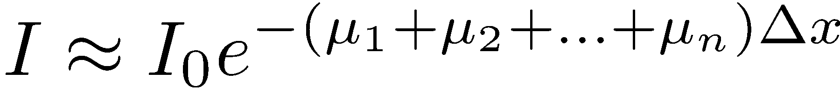
Attenuation: nonuniform material
. . .
Riemann Sum

Slide 16
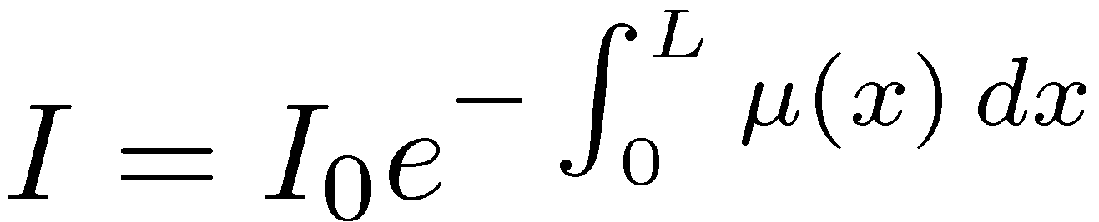
Attenuation: nonuniform material
. . .

Slide 17
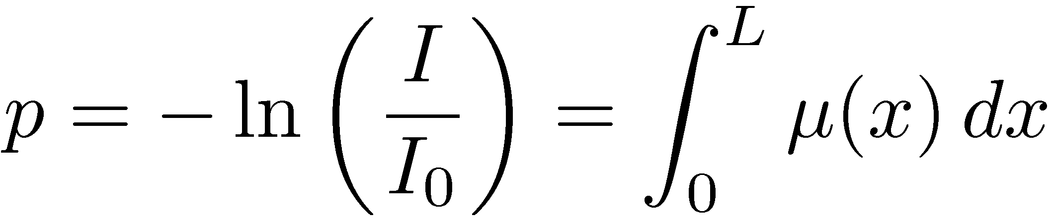
What is known?
measureable output x-ray intensity
known input x-ray intensity
x-ray projection
Notes:
The map of mu(x) into its’ line integrals the radon transform of mu(x)

Slide 18
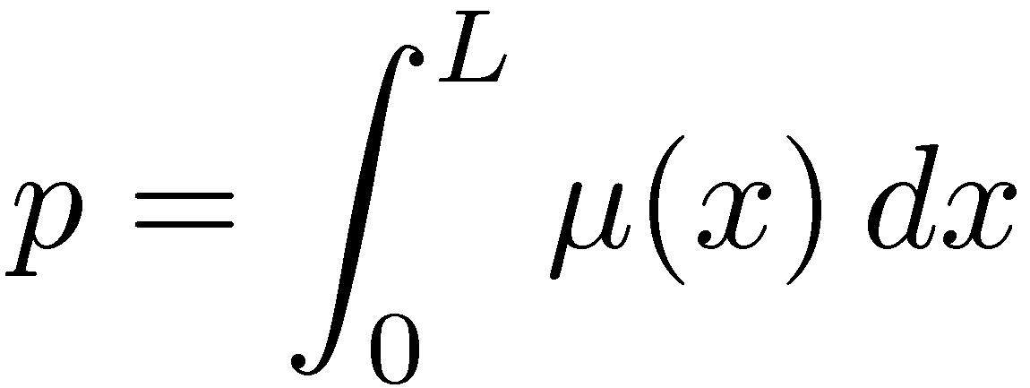

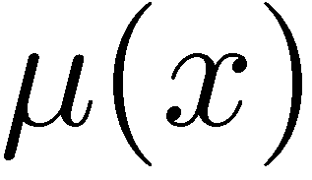
What is known? What is unknown?
KNOWN!
UNKNOWN!
Inverse problem, image reconstruction problem
Given:
Find:

Slide 19
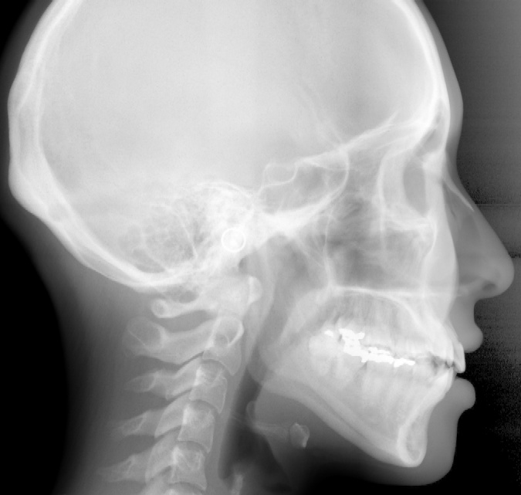
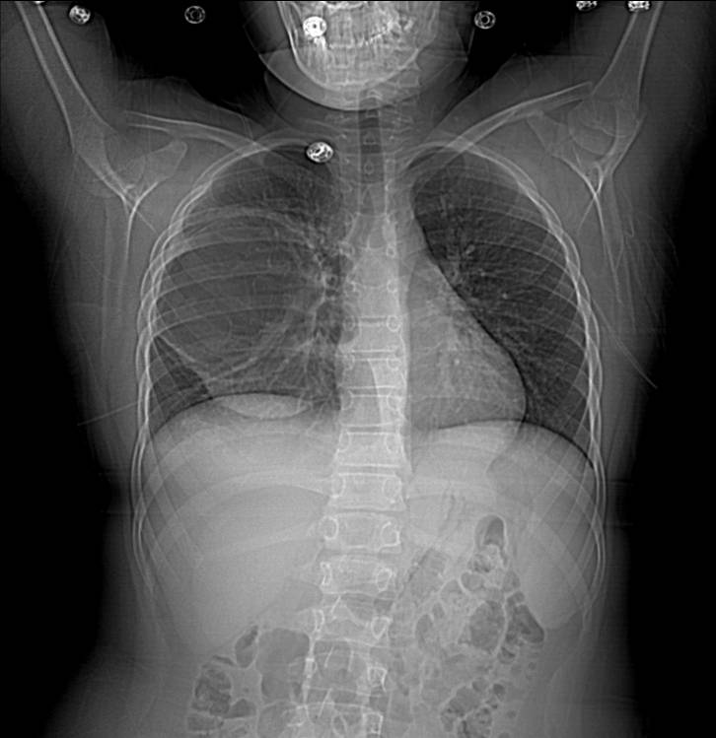
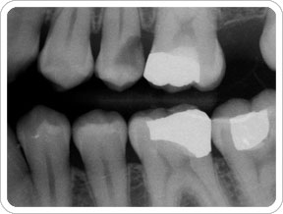

X-rays: Shadows

Slide 20
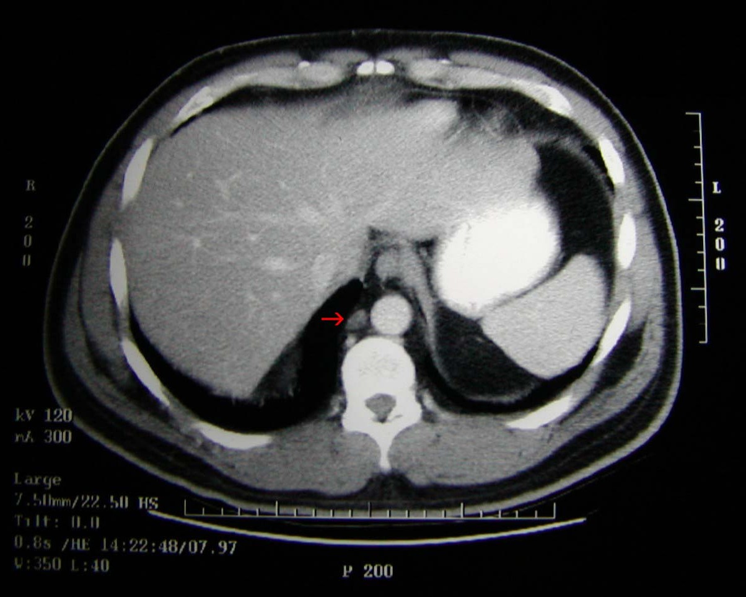
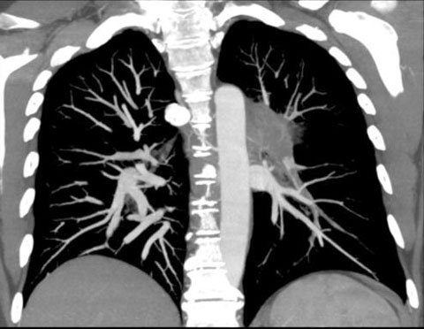
Tomography: solve for
Tomography: “Any of several techniques for making detailed x-rays of a
predetermined plane section of a solid object while blurring out the images
of other planes.”
Chest Computed Tomography (CT) Images
1 cm carcinoma
pulmonary embolism

Slide 21
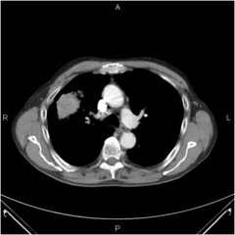
Patient’s CT Scan
Photo credit: Dr. Joseph Levine
Notes:
Red arrow to the clearly visible mass, as well as what other objects are
Notice in this case – one cross section is enough for now, but….
- Mass 7cm across
- Enlarged lymph nodes

Slide 22
Basic idea: view 1
Semi-opaque cylinder with 5 smaller cylinders embedded
light
Top view

Slide 23
Basic idea: view 2
Semi-opaque cylinder with 5 smaller cylinders embedded
light
Top view

Slide 24
CT systems
x-ray source
x-ray source
detector
detector
parallel beam
fan beam
Notes:
So how do we get these great CT images? CT scanners measure I, the x-ray intensity after attenuation through the patient. For some small block of width delta x with constant attenuation f, the x-ray intensity leaving the object can be determined by solving dI/dx = -f I with initial condition being the initial intensity of the x-ray beam. Building this up for many small blocks with width delta x and different constant attenuations, and in the limit as delta x goes to zero, we can write blah. Taking the log of both sides and defining g = …, we have the following integral equation. G here is called the measured projection, which is given, since we know the initial input intensity and the measured intensity from the scanner. So the goal is, given these measured projections g, can we determine the patient’s attenuation function f. Or, solve an integral equation.
Now we have the model for one x-ray. But for a CT scan, we use many x-rays. The simplest configuration is to have an x-ray source on a line and a detector directly across from it, with the x-ray beams running parallel to each other. Then after the x-rays hit the detector, we rotate the entire configuration, and do it all again. This was the first type of scanner built in the 70s; no one uses this anymore. A more complicated version is the one shown here, called fan-beam because the x-ray source emanates from a point in a fan. The detector is curved.

Slide 25
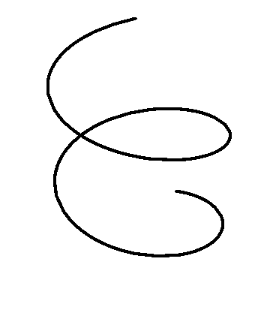
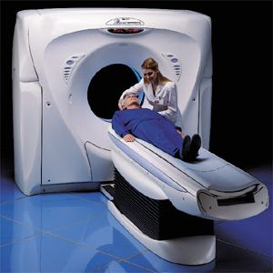
Modern CT system
Helical configuration

Slide 26
Break

Slide 27
What is an image?
v2,5 = 0.5
column
An image is a matrix
A pixel vi,j is a value in a matrix
For a simple greyscale image, black=0, white=1, and numbers in-between represent greys
1
2
3
4
5
row
1
2
3
4
5
v5,1 = 1
v4,4 = 0

Slide 28
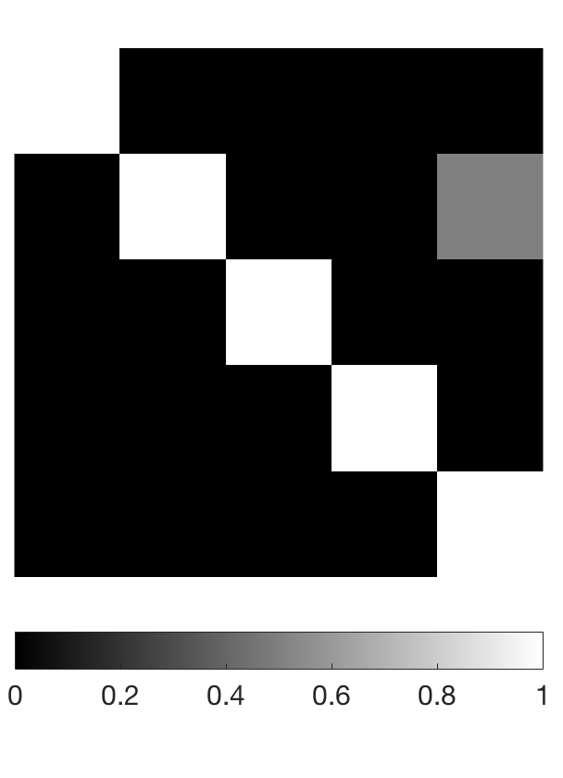
Matlab: simple image
clear all;
close all;
N = 5;
V = eye(N);
%identity matrix:
%1 = white, 0 = black
imshow(V, 'InitialMagnification', 'fit');
colorbar
%change element (2,5) to gray
V(2,5) = .5;
imshow(V, 'InitialMagnification', 'fit');
colorbar('southoutside', 'Fontsize', 15);

Slide 29
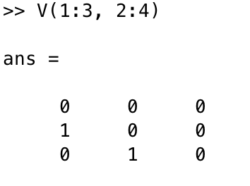
Matlab: simple image
column
row

Slide 30
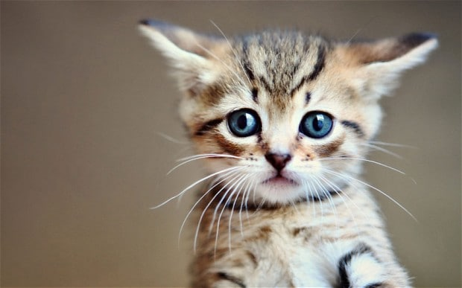
Real images
http://www.telegraph.co.uk/news/newstopics/howaboutthat/11963318/Uber-delivers-cute-kittens-to-stressed-workers-on-National-Cat-Day.html

Slide 31
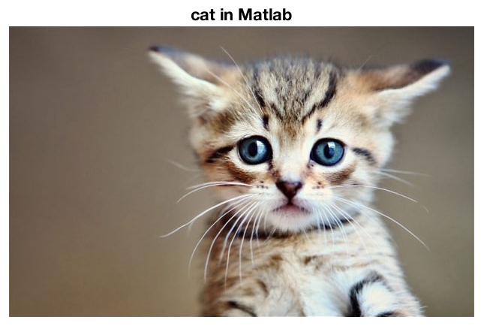
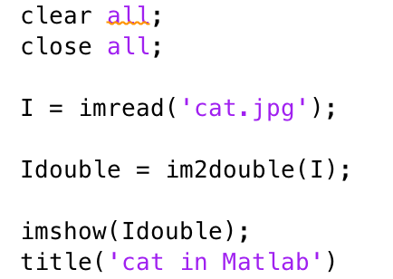
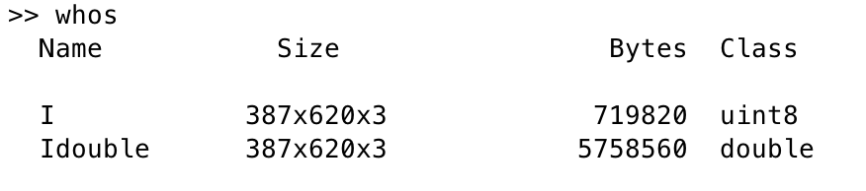
Kitten in Matlab
How big is the image? Type whos.
Kitten is a 387 by 620 by 3 matrix (the third dimension is for color)

Slide 32
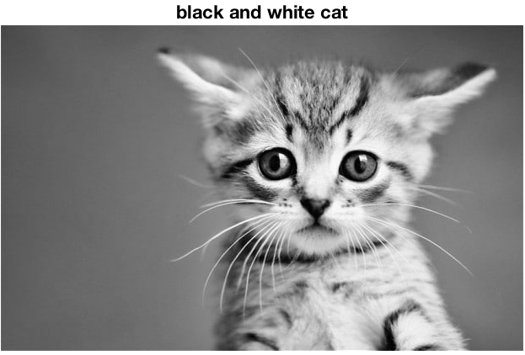
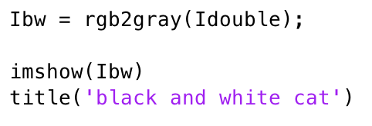
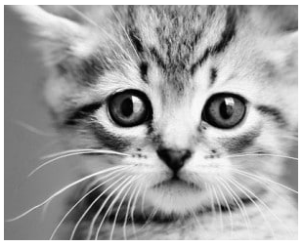
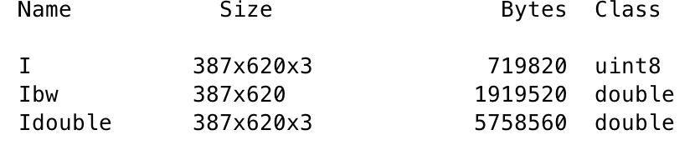

Kitten in Matlab
Black and white kitten is 387 x 620

Slide 33
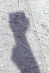
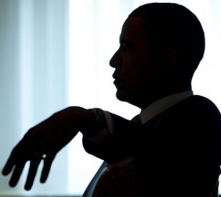
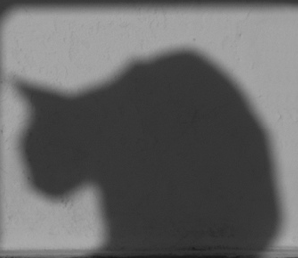
Partial information: shadows

Slide 34
Radon transform
rows
columns
0
0
1
1
1
1
0
0

Slide 35
Radon transform
row i
0
0
1
1
1
1
0
0

Slide 36
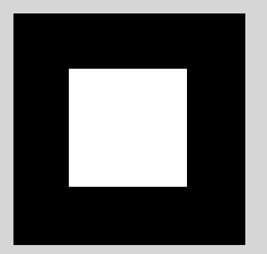
Shadows: Radon transform
Radon Transform

Slide 37
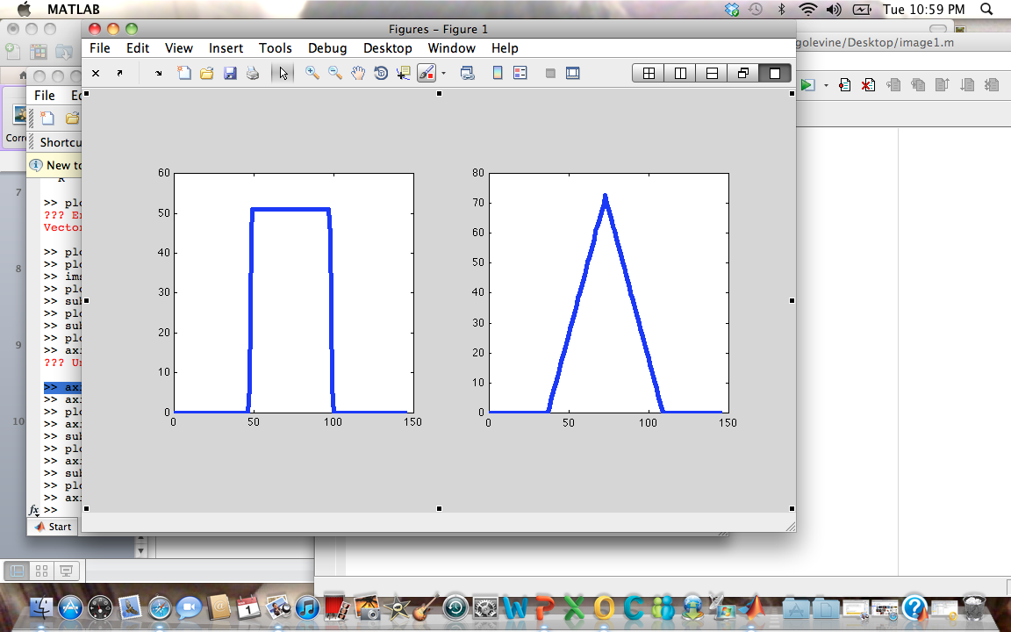

Radon transform
Image
Radon Transform R

Slide 38
Second view: Radon transform

Slide 39

Second view
Image
Radon Transform R

Slide 40
Lab next Tuesday
Images and Radon transform in Matlab
Bring your computer!

